Slide 1

“FitBuddy Android App”
Project Presentation
In partial fulfillment for the award of the degree of
BACHELOR OF TECHNOLOGY
In
COMPUTER SCIENCE AND ENGINEERING
Submitted By
Komal Kumari (1904230100026)
Nazeem Ahmad (1904230100036)
Under the supervision of
Ms. Niyati Gaur
(Assistant Professor)
SCHOOL OF MANAGEMENT SCIENCES, LUCKNOW
(Affiliated to Dr. A.P.J Abdul Kalam Technical University, Lucknow (UP)
March , 2023

Slide 2
CONTENTS
Introduction
Objective
Hardware & Software Requirements
Data Flow Diagram(DFD)
Entity Relationship Diagram(ER)
Gantt Chart
Modules
Screenshots
Conclusion
Future Scope
Reference

Slide 3
INTRODUCTION
FitBuddy is personal trainer fitness android app that helps users reach their fitness goals.
FitBuddy offers: Personalized workout plans, Customized Diet chart, Progress tracker, BMI Calculator, Step count, Workout and meal reminders and many more
The entire application is developed on Android Studio using Java, Kotlin and Xml.
The FireBase database used to store and retrieve data and also for authentication process in app.
The system is user-friendly and easy to operate, making it accessible to users with varying levels of technical expertise.

Slide 4
OBJECTIVE
To help users who are new to fitness and deliver them a personalized fitness experience that is convenient, motivating, and effective.
Features:
Personalized workout plans based on user goals and fitness level
Real-time tracking of progress with step counts, calories burned, and other metrics
Notification reminder.
Customized Diet Chart.
Target Audience:
People who can’t afford a Trainer initially.
People who have to travel a lot and can’t join a Gym due to location Variation.
People who want to improve their overall health.

Slide 5
HARDWARE & SOFTWARE REQUIREMENTS
Software Requirements
Android Version > V 5.0
Android emulator (Blue Stacks)
Hardware Requirements
Chipset supporting android/ linux architecture.
Ram >2GB
Max. 500 mb free storage

Slide 6
DFD ( Data Flow Diagram) : LEVEL 1
Registration
User Login
Workout
Pedometer
FitBuddy
progress
FAQ
Nutrition & Macros
Logout

Slide 7
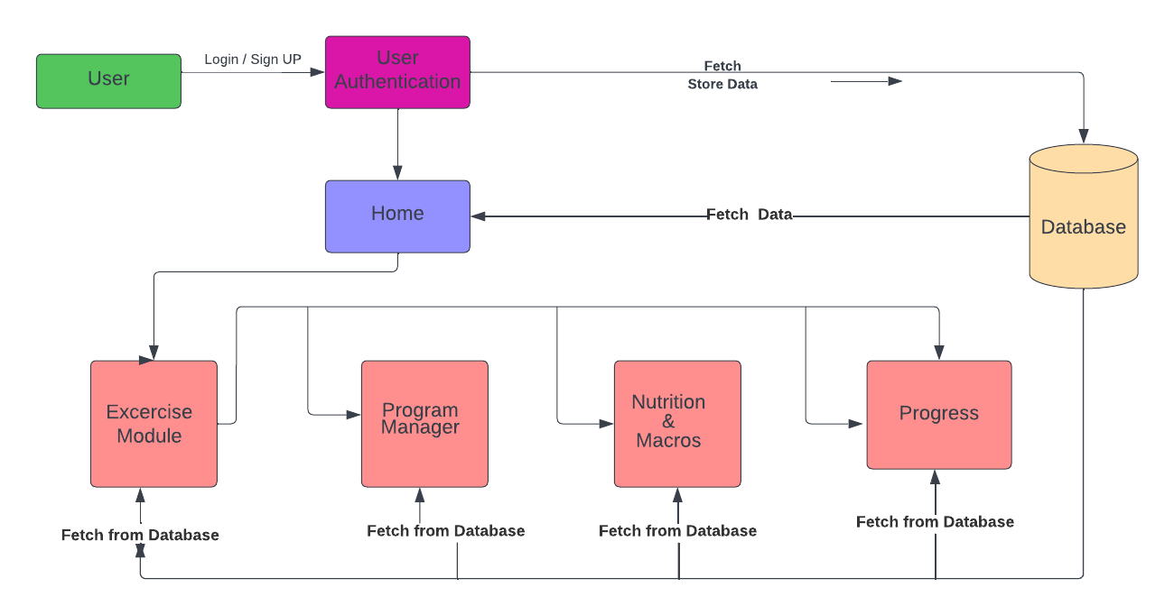
DFD ( Data Flow Diagram) : LEVEL 2
DFD ( Data Flow Diagram) : LEVEL 2

Slide 8
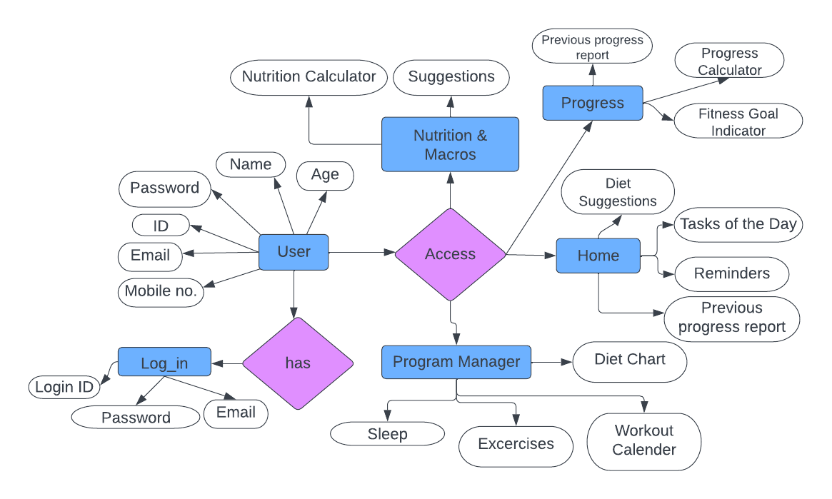
ER DIAGRAM

Slide 9
GANTT CHART
SDLC Activities | OCT | NOV | DEC | JAN | FEB | MAR | APR | MAY
Planning
Analysis
Design
Coding
Testing
Implementation

Slide 10
MODULES
Authentication MODULE
LogIn MODULE
Exercise MODULE
Progress MODULE
Nutrition And Macros MODULE
Program Manager MODULE

Slide 11
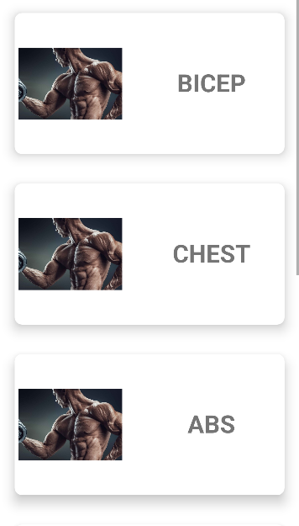
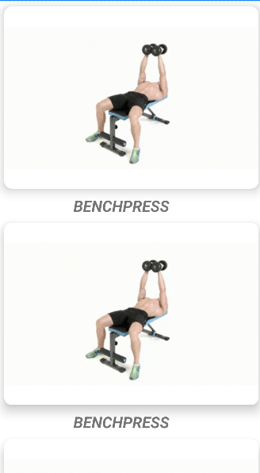
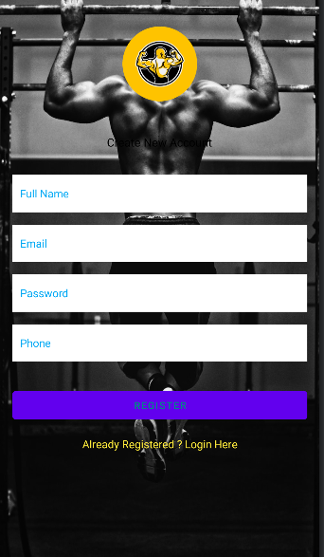
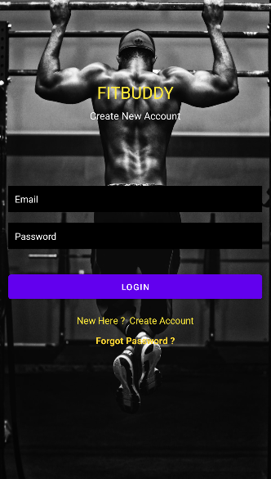
SCREEN SHOTS
Register PAGE
LOGIN PAGE
Focused Body Area
Exercise PAGE

Slide 12
CONCLUSION
In conclusion, FitBuddy app is a great way to stay motivated and on track with your fitness goals. It offer a variety of features that can help you track your progress, find new workouts. If you're looking for a way to improve your health and fitness, a fitness app is a great option.
Here are some of the benefits of using a fitness app:
Motivation: Fitness apps can help you stay motivated by tracking your progress and providing you with encouragement.
Variety: Fitness apps offer a variety of workouts to choose from, so you can find something that fits your interests and fitness level.
Convenience: Fitness apps are convenient because you can use them on your phone or tablet, wherever you are.
If you're looking for a way to improve your health and fitness, a fitness app is a great option, as it pocket friendly and accessible from any location.

Slide 13
FUTURE SCOPE
Include feature like “Local GYM Locator”.
Add shopping Section for Supplements.
Create a community to let users support each other.
Informative fitness related content that educates users in fitness community.
Introduce a blog section where users can write and share their experience.
Monetize app for users to earn as a side hustle income

Slide 14
REFERENCES
https://www.youtube.com/watch?v=uDC_YGLZblY
https://en.wikipedia.org/wiki/Fitness_app
https://mhealth.jmir.org/2018/9/e174
https://ieeexplore.ieee.org/abstract/document/8328407
https://link.springer.com/chapter/10.1007/978-981-16-4538-9_40
https://mhealth.jmir.org/2015/1/e8

Slide 15
THANK YOU !

